Slide 1

LLM MODELS Week 1: Introduction
Pedro Elias eres Salazar
B.Sc. in Electronic Engineering, Universidad de los Llanos
Specialization in Industrial Instrumentation and Control, Universidad de los Llanos
Specialization in Business Intelligence, Universidad Pontificia Bolivariana (UPB)
Candidate for Master's in Embedded Artificial Intelligence, Universidad de Buenos Aires (UBA)

Slide 2

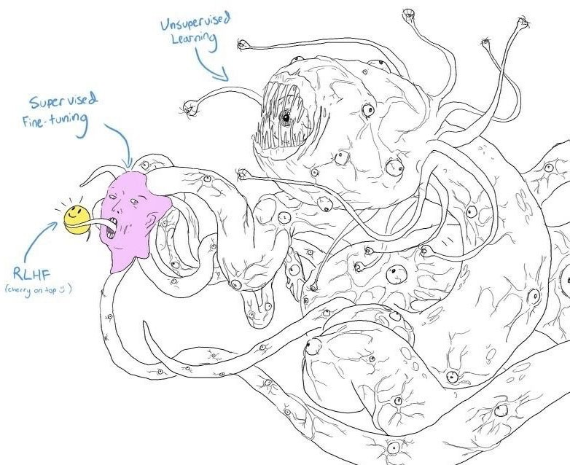
Content
1. Understanding Language Models
2. The Evolution of Language Models
3. Large Language Models (LLMs)
4. Types of LLMs
5. Tools for Working with LLMs

Slide 3
Understanding Language Models
Section 1

Slide 4



What are Language Models?
Definition
Language models are systems that automatically understand and generate natural (human) language. They have evolved from probability-based models and computational linguistics to today's deep neural networks.
Applications
These models are integral to various applications such as automatic translators, search engines, spell checkers, virtual assistants.
01
02

Slide 5
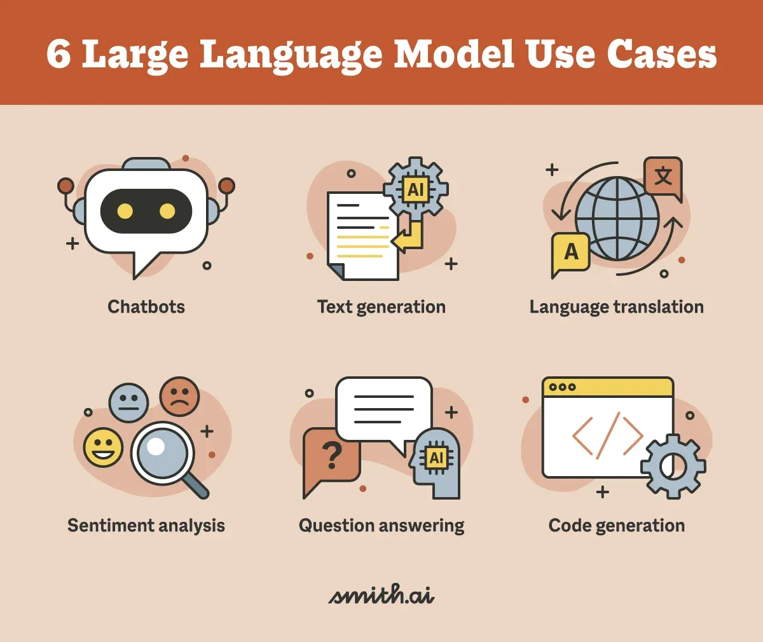
What are Language Models?
Applications
These models are integral to various applications such as automatic translators, search engines, spell checkers, virtual assistants.
02

Slide 6
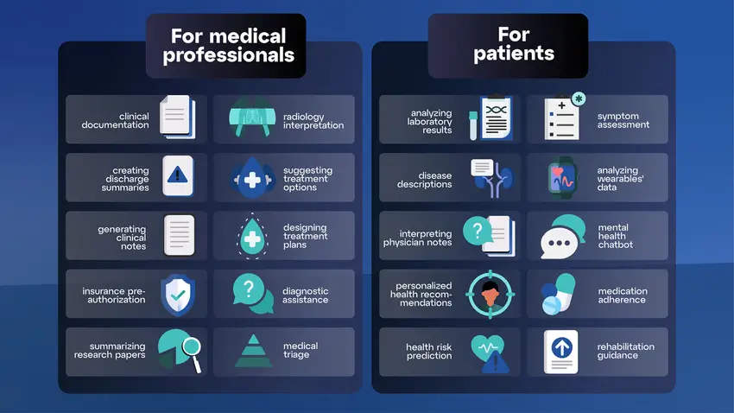
What are Language Models?
Applications
These models are integral to various applications such as automatic translators, search engines, spell checkers, virtual assistants.
02

Slide 7
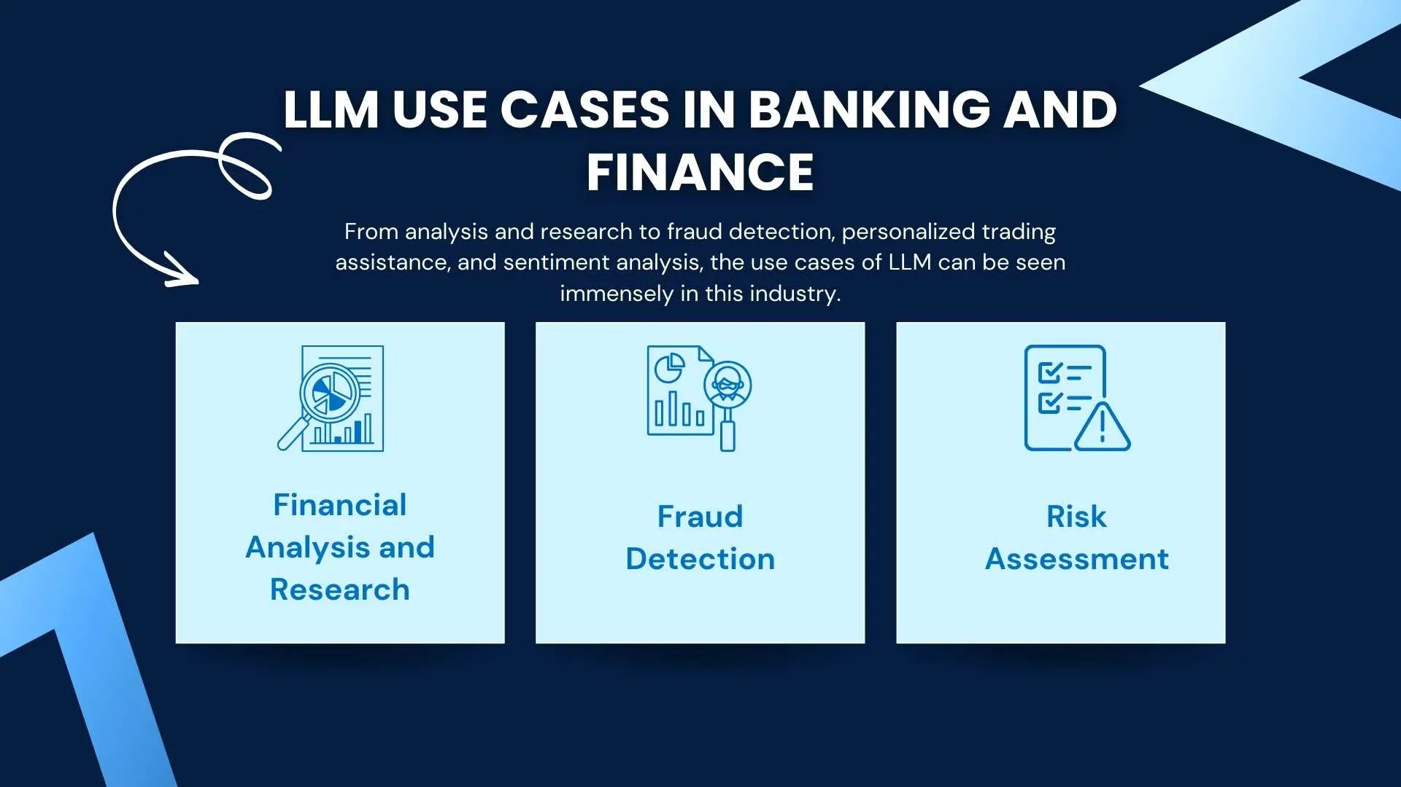
What are Language Models?
Applications
These models are integral to various applications such as automatic translators, search engines, spell checkers, virtual assistants.
02

Slide 8

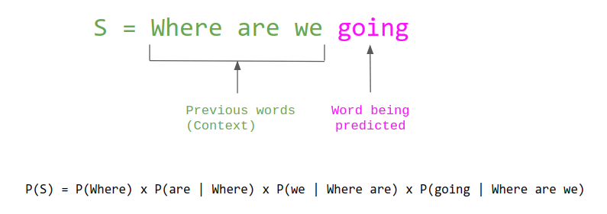




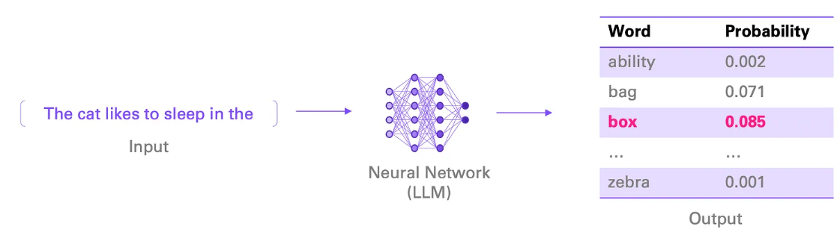
The Concept of Language Models
Probability Distribution
A language model describes a probability distribution over sequences of tokens, denoted as P(w1, w2, ..., wm). Calculating this distribution is computationally infeasible, so Machine Learning models or neural network architectures are used as approximations.
A language model describes a probability distribution over sequences of tokens:
P(w1, w2, ..., wm)
Example
Let's consider an engaging challenge: What would be the next word after this sequence? 'The cat likes to sleep in the ...' Now, let's think about how we can approach this from a machine learning perspective. Is it possible to treat this as a problem within the realm of machine learning? Absolutely! More specifically, it's a classification task where we predict the next word based on the sequence of words that come before it.
Computationally, it is impossible to calculate this probability distribution. It is approximated through Machine Learning models or neural network architectures
The cat likes to sleep in the...
LLM

Slide 9
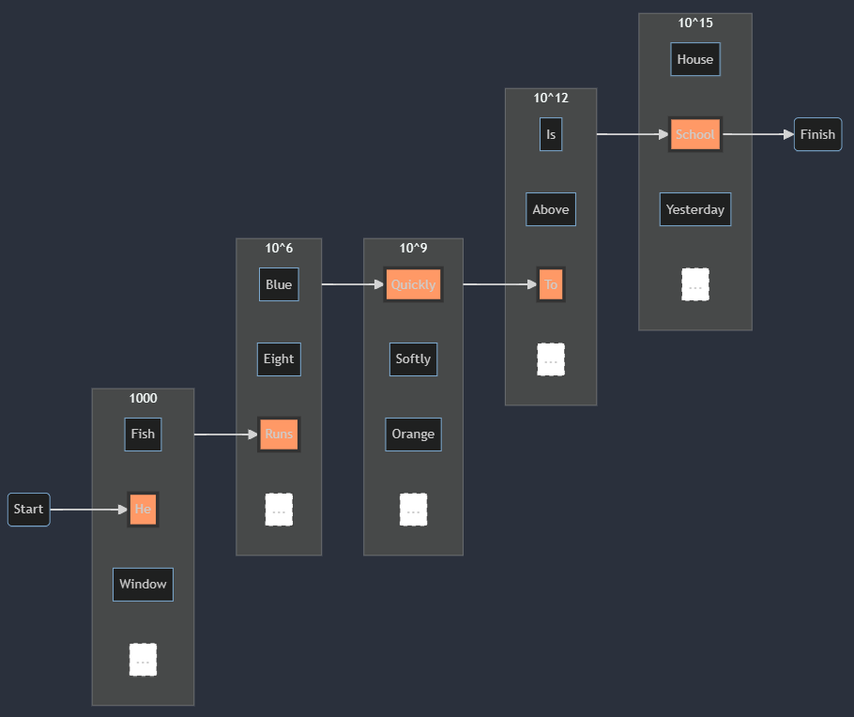
Example of Word Ordinality Calculation
Vocabulary Size: 1000

Slide 10
Short and Long-Term Memory
Short-term memory in language models captures the immediate context for generating coherent responses. Long-term memory is the extensive knowledge and training built into the model, plus any external databases it can access for information beyond its immediate context.
Once upon a time, there was a small town surrounded by green meadows and mysterious forests. In this place, lived a young man named Lucas, who always dreamed of adventures beyond the limits of his home. The routine of everyday life overwhelmed him, and he longed to explore the world that stretched out before his eyes.
One day, while Lucas was exploring the forest near his home, Lucas found a strange glowing stone. Upon touching it, Lucas felt a warm and comforting sensation. The stone was magical and had the power to turn into reality anything that Lucas could imagine.
One day, while he was exploring the forest near his house, he found a strange glowing stone. Upon touching it, he felt a warm and comforting sensation. The stone was magical and had the power to make any imagination a reality.
LLM
Short Term Memory
Long Term Memory

Slide 11





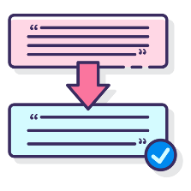
General Definitions
Corpus
A collection of text or audio organized into datasets.
Vocabulary
The unique words in a corpus, representing the basic units used to construct sentences.
Document
A text unit containing significant information.
Token
An individual unit of text, which can be a word, character, or subset of characters.
Sentence
A grammatically structured and meaningful sequence of words.
Key Principles of Natural Language Processing for Models

Slide 12

The Evolution of Language Models
Section 2

Slide 13



History of Language Models
Early Beginnings
Language models have been around for over a century, with various tools developed using them, such as ChatGPT and Eliza, the first conversational bot.

Slide 14

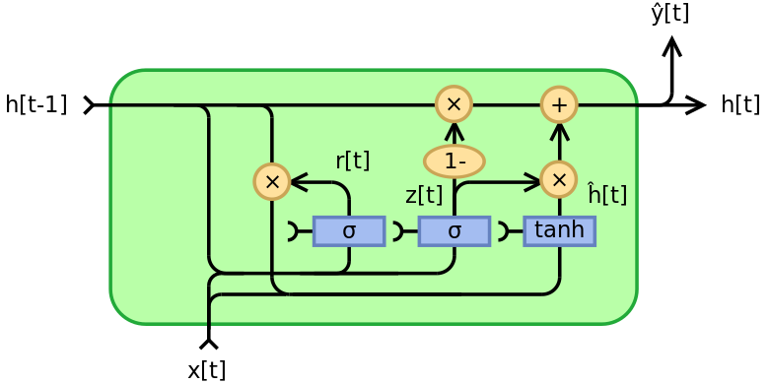
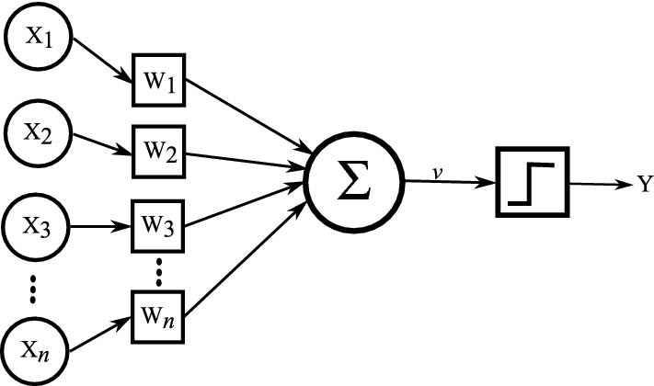
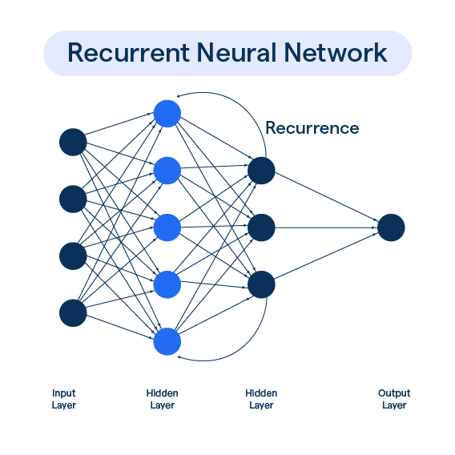
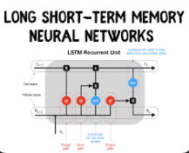
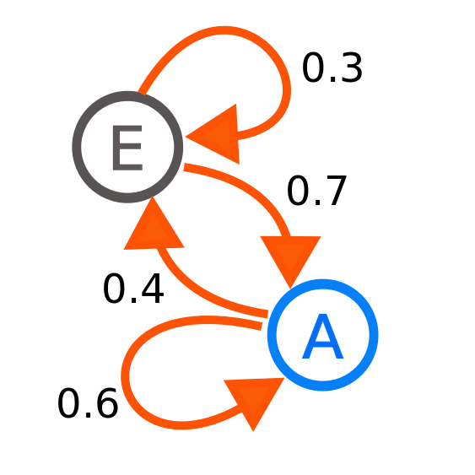
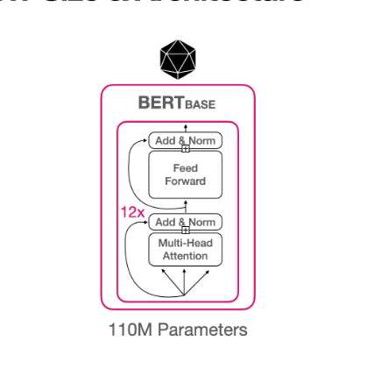

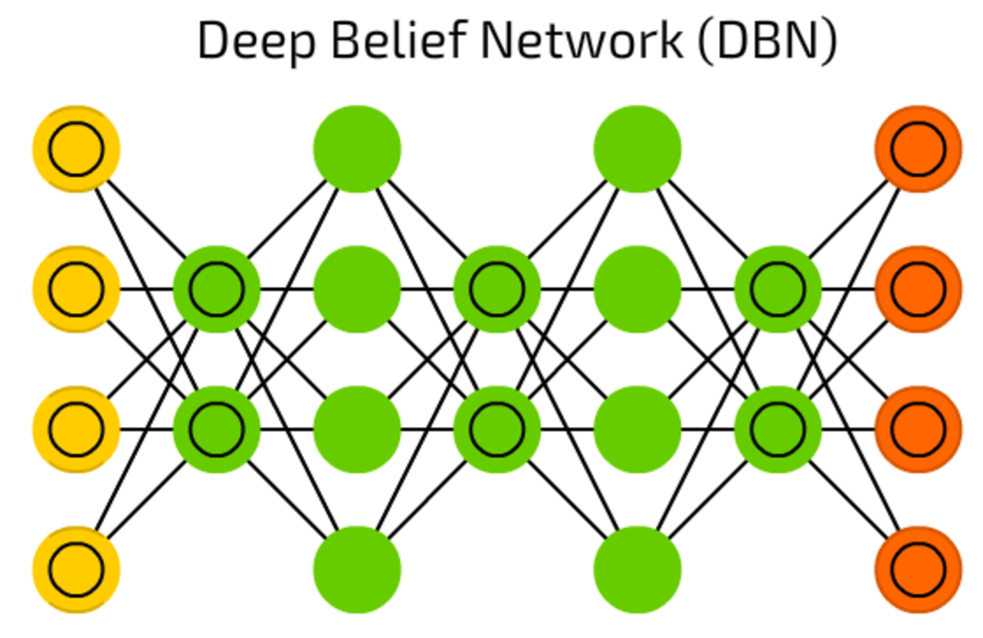
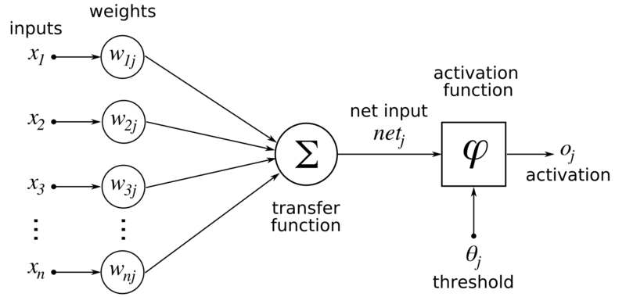
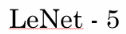
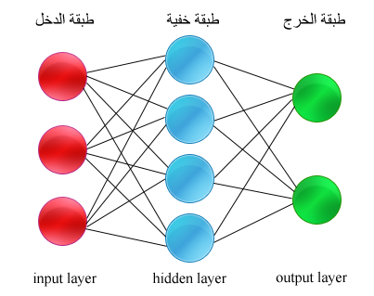
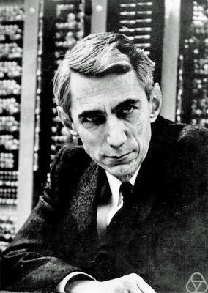
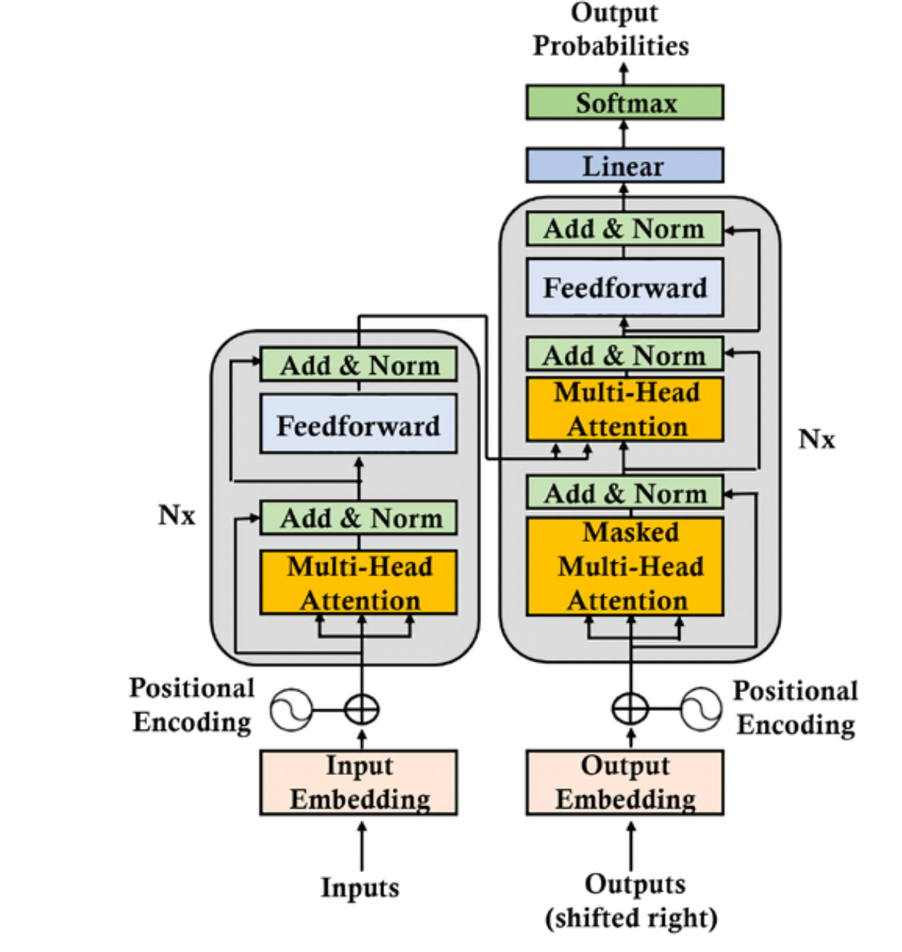
History of Language Models
1957
Rosenblatt’s Perceptron
2014
Gated Recurrent Units (GRUs)
Introduction of Attention Mechanisms
2019 onwards
Emergence of GPT models
widespread use of Transformers
1913
Markov Models
1986
Introduction of RNNs
1997
LSTM Networks
1966
Eliza Chatbot
2018
BERT Model
1943 McCulloch & Pitts Neuron
1989
LeNet-5 CNN
2006
Deep Belief Networks
1986
Backpropagation Popularized
1948
Shannon’s Text Generation
Using Probabilistic Models
2017
Transformer Architecture

Slide 15
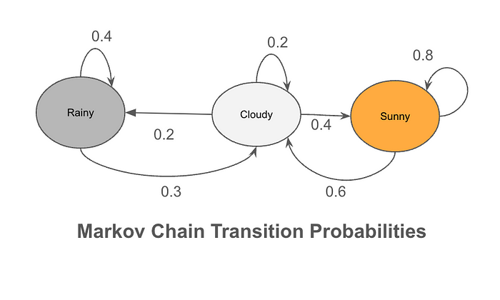
Markov Chains and Text Generation
Probabilistic Text Generation
Representations based on counts of word and character sequences (N-grams) were used, and in 1948, Claude Shannon utilized Markov chains to generate text automatically.
Claude Shannon's 1948 Method: Utilizing N-grams in probabilistic text generation.
Predictive Text Chains: Selecting words based on the likelihood of their sequence.
Beginning to End: Starts with an initial symbol, ends with a termination symbol.
Foundational Work: Pioneered the use of statistical models in language processing.
Markov Chains
In 1913, Markov chains were used as the basis for probabilistic language models, with Andrey Markov creating them in 1906 to describe probabilities in a sequence of dependent events.

Slide 16
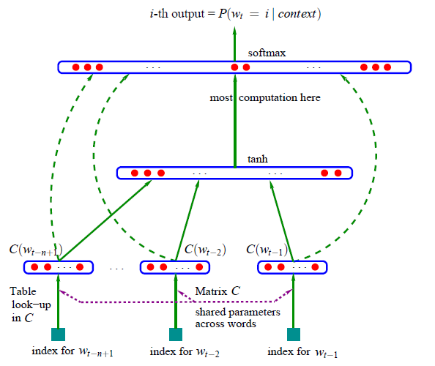
Neural Networks in Language Modeling
A neural probabilistic model as an approximator of probability distributions.
A neural probabilistic model as an approximator of probability distributions.
A neural probabilistic model as an approximator of probability distributions.
Neural networks have been researched since 1943
with the neural networks of McCulloch & Pitts.
In 2003, Yoshua Bengio
and others published the
article
"A Neural Probabilistic Model
A neural probabilistic model as an approximator of probability distributions.

Slide 17
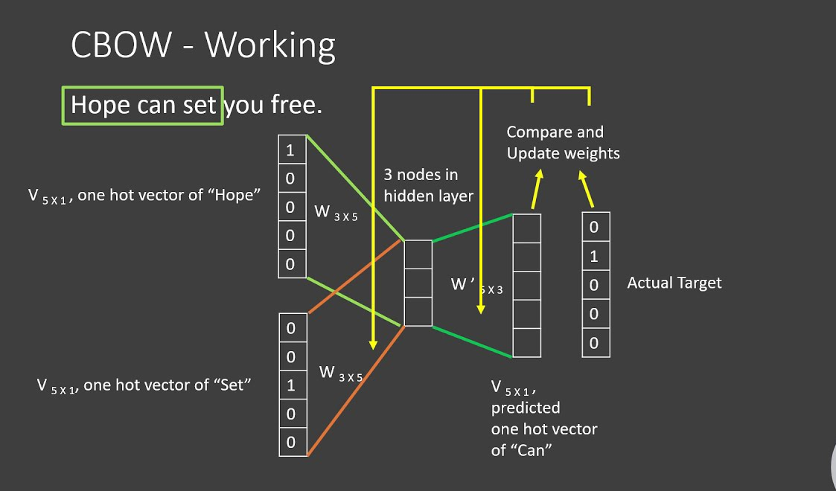
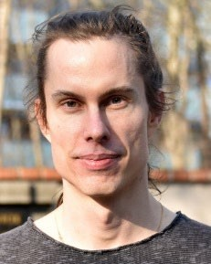
Embeddings and Semantic Models
Word Embeddings
In 2013, Tomas Mikolov introduced word representations using embeddings, which capture semantic relationships in a continuous numerical space, achieved with contextual models like Word2Vec.

Slide 18


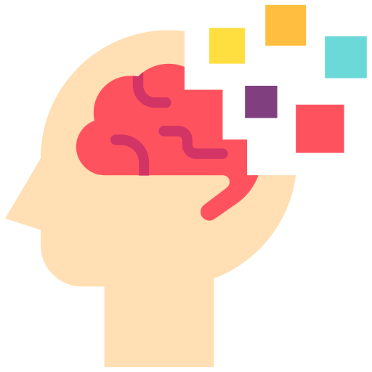
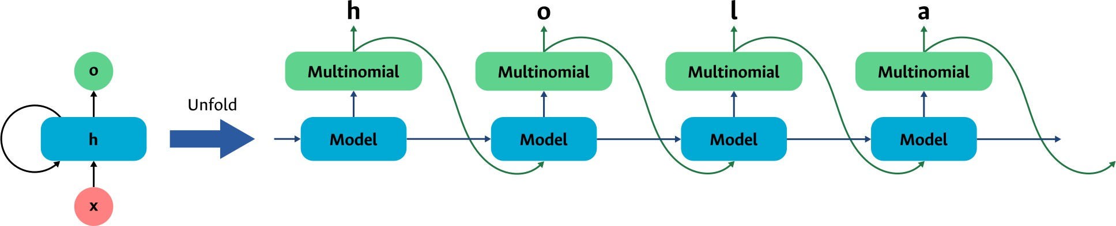
Sequential Neural Models
The earliest models were the recurrent neural networks proposed by John Hopfield in 1982
These models included a mechanism to represent memory in neural networks.
They function similarly to the way we read texts: sequentially and using memory to understand

Slide 19



Attention Mechanisms
This gave rise to the models known as transformers.
Importance of Words
Attention mechanisms weigh the importance of words within a sequence for a specific task. They were used alongside recurrent networks to improve memory representation. In 2017, Ashish Vaswani and others demonstrated that attention mechanisms were more crucial than recurrent networks in language modeling, leading to the development of transformer models.
They weigh the importance of words
within a sequence for a specific task.
These were being used alongside
recurrent networks as a way
to improve memory.
This gave rise to the models known as transformers.
Arquitectura general de un transformer,
tomada del artículo Attention is all you

Slide 20
Large Language Models (LLMs)
Section 3

Slide 21

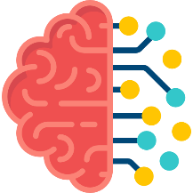



Defining LLMs
Deep Neural Networks
LLMs (Large Language Models) are based on the transformer architecture, a type of deep neural network specifically designed to handle sequential data. Unlike traditional machine learning models that simulate human brain function through layers of interconnected nodes, transformers use mechanisms like attention to process inputs in parallel. This architecture allows LLMs to efficiently manage and learn from massive datasets, significantly enhancing their capability to understand and generate human-like text
Deep Neural Networks
A machine learning model designed to simulate the functioning of the human brain.
Training and inference strategies
This involves adjusting the model parameters using datasets.
How the model makes predictions or generates results once it has been trained.
Transformers
Neural network architecture used for natural language processing (NLP) tasks.
LLMs are transformers trained on massive data sets and have a large number of parameters (ranging from 10⁹ to 10¹¹).

Slide 22
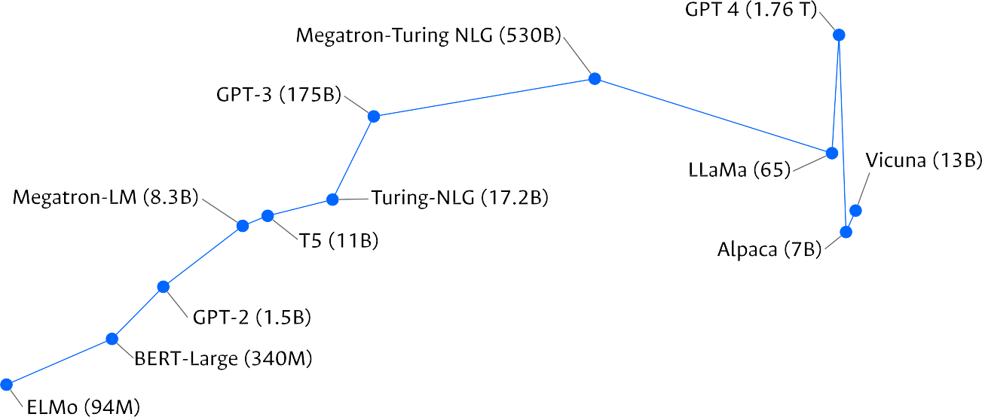
Defining LLMs
Evolution of Language Models
ELMo (2018, 94M): Pioneered contextualized word embeddings.
BERT-Large (2018, 340M): Introduced deep bidirectional representations.
GPT-2 (2019, 1.5B): Notorious for potential misuse in content generation.
Megatron LM (2019, 3.3B): Optimized for efficient GPU training by NVIDIA.
T5 (2020, 11B): Generalized NLP tasks into a text-to-text format.
Turing-NLG (2020): Integrated language generation with a pre-trained transformer.
GPT-3 (2020, 175B): Vastly influential in broad-spectrum AI applications.
Megatron-Turing NLG (2021, 530B): A powerful model merging NVIDIA and Microsoft technologies.
LLaMA-65B (2023, 65B): Known for efficiency, smaller size but powerful.
GPT-4 (2023, 1.76T): Features trillions of parameters with advanced reasoning.
ALPACA-7B (2023, 7B): Specializes in deep language understanding.
Vicuna-13B (2024, 13B): Excels in specific applications, strong in reasoning.
Model size (in billions of parameters)
10000
1000
100
10
1
0.1
0.01
2018
2019
2021
2022
LLMs are transformers trained on massive data sets and have a large number of parameters (ranging from 10⁹ to 10¹¹).

Slide 23
Neural Networks and Transformers
Neural networks are a type of bio-inspired models capable of approximating any problem through various mathematical operations.
Red Neuronal
Red Neuronal
They have proven to perform better than humans in various tasks such as voice and object recognition, automatic translation, and automatic text generation.
Capa de entrada
Capas ocultas
Capa de salida

Slide 24
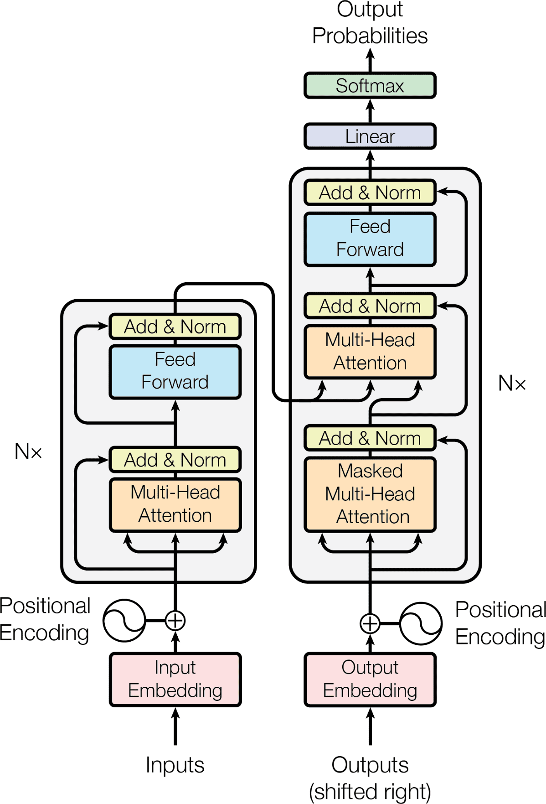
Transformers
DECODER
Takes the abstract representation generated by the encoder and uses it to generate an output sequence.
The transformers are the type of neural network designed to process text efficiently.
Different Learning Strategies
Various learning strategies have been used to train LLMs effectively, such as alignment, self-instruct, and low-rank adaptation.
They consist of 3 components:
Embedding
Multihead Attention
Positional Encoding
ENCODER
It takes an input sequence and transforms it into an abstract representation called an embedding or latent representation.

Slide 25
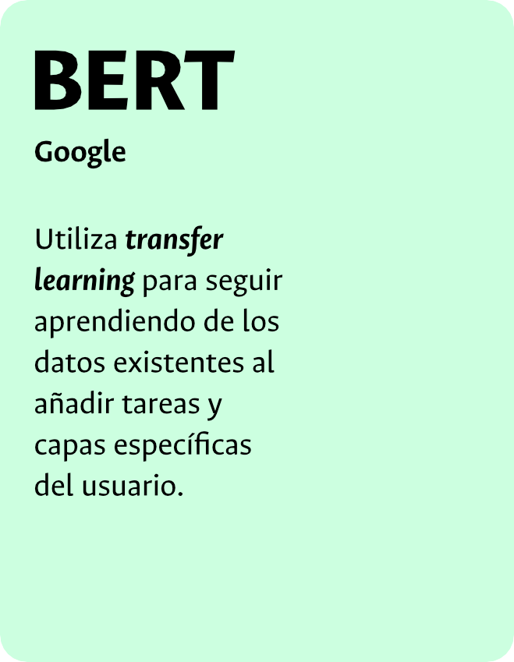







Transformers
BERT
It decodes from its massive pre-trained embeddings to present a result that matches the user's prompts.
Uses transfer learning to continue learning from existing data by adding tasks and user-specific layers.

Slide 26
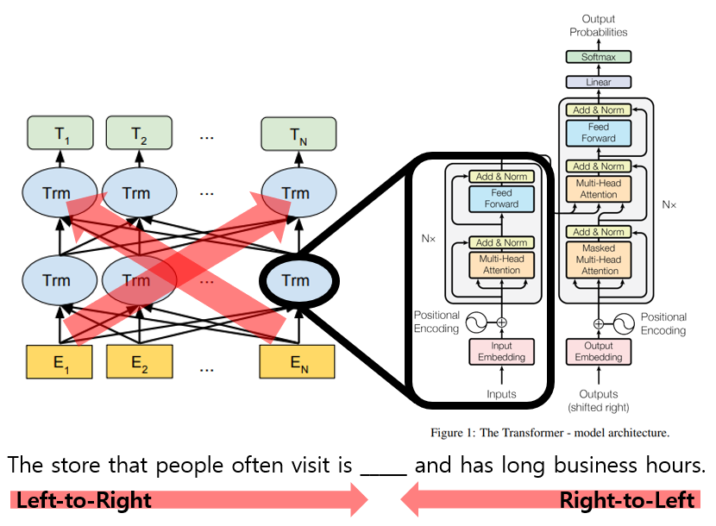

Transformers-Encoders
Encoder
BERT
Contextual Representation: By the time the information reaches the final layer, each embedding has been transformed into a contextualized representation. This means the embedding for each [MASK] token now has a detailed understanding of the context within which it appears, derived from both the preceding and following words in the sentence.
Information Flow Between Layers: As the embeddings pass through BERT's multiple layers, the flow of information is bidirectional. Each layer consists of self-attention mechanisms that allow the embeddings to be updated based on information from all other words in the sentence. The embeddings for the [MASK] tokens, therefore, become a composite representation of their surrounding context as they flow through each successive layer.
Uses transfer learning to cotinue learning from existing data by adding tasks and user-specific layers.
Input: The process starts with the input sentence, "The child goes to [MASK]. They have [MASK] of mathematics." Each word, including the [MASK] tokens, is converted into a vector known as an embedding. These embeddings are rich in semantic information but do not yet consider the sentence's context.

Slide 27
Transformers-Encoders
Encoder
BERT
BERT is a multi-layer bidirectional transformer encoder. The architecture of BERT allows the model to know all contexts. BERT representations are jointly conditioned on both left and right contexts in all layers.
Input: The child goes to [MASK]. They have [MASK] of mathematics.
Labels: [MASK] = school, [MASK] = class
Uses transfer learning to continue learning from existing data by adding tasks and user-specific layers.
It is trained with a Masked Language Modeling approach.
Each word has access to both previous and subsequent words.

Slide 28
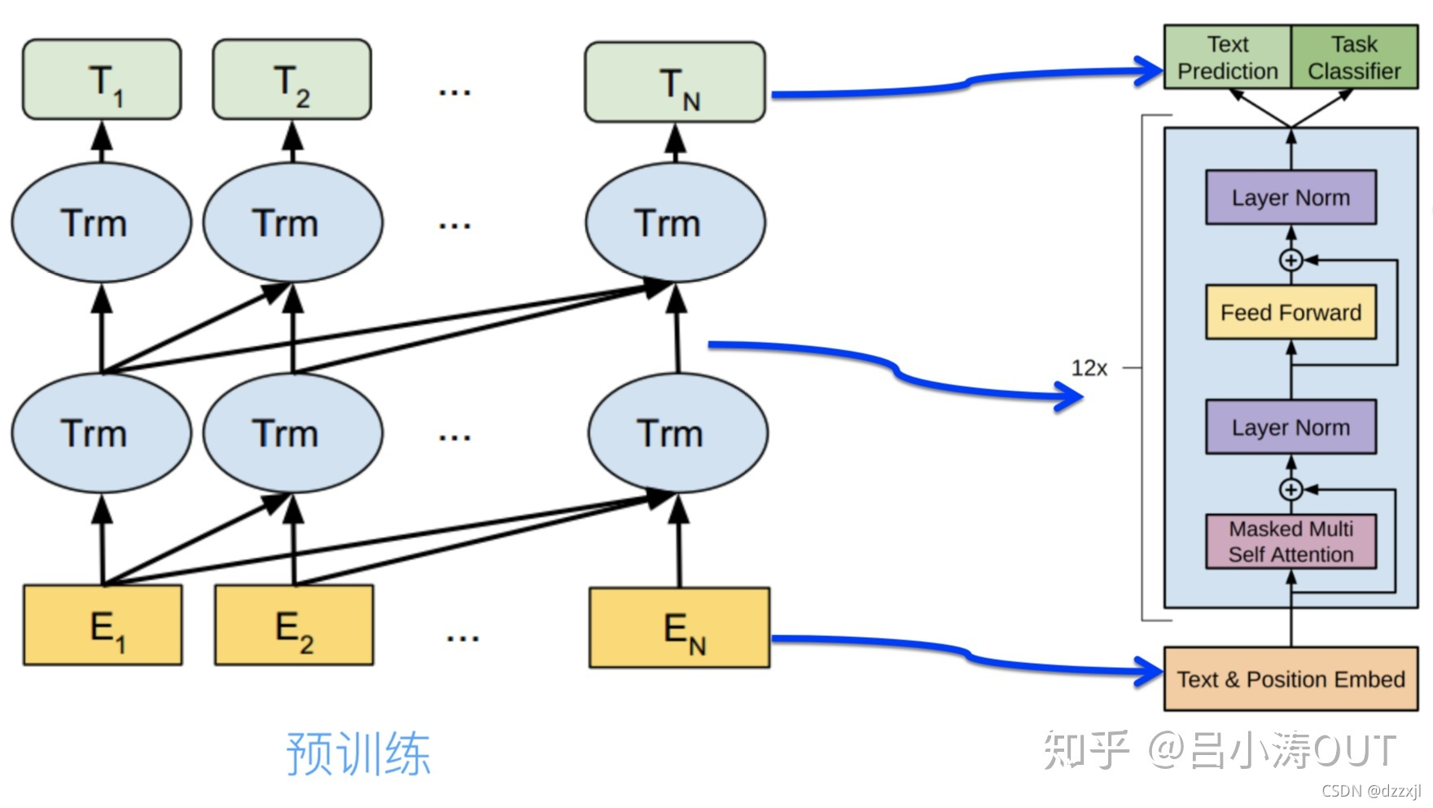
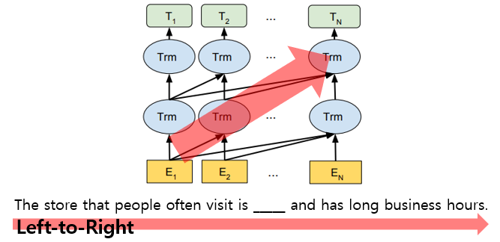
Decoders
BERT
It decodes from its massive pre-trained embeddings to present a result that matches the user's prompts.
The GPT decoder operates in a left-to-right manner and is trained with a focus on Causal Language Modeling:
It is designed to predict each token based solely on the preceding tokens, following a unidirectional, or left-to-right, flow of information.
This training approach allows GPT to learn general language representations by considering the context to the left of each token without any future insight
By utilizing Causal Language Modeling, the model generates new words taking into account the entire sequence of words that came before, thereby constructing a coherent narrative or response.

Slide 29
Trasnformers
BERT
Positional encoding is like a name tag for each word in a sentence, telling the model the exact spot where the word stands, kind of like assigning a seat number to every word in a theater so the model knows who sits where.

Slide 30
Trasnformers
BERT
Multihead Attention
Multihead Attention is like a team of judges in a talent show, where each judge focuses on different qualities of the performers to decide how much attention each one deserves based on their overall performance.
Multihead Attention
It's a layer that weighs each word based on its relationship with the rest of the words for the task at hand

Slide 31
Trasnformers
BERT
The "Add & Norm" step is like quality control, making sure that the enhancements keep the original good features of the product and that everything stays in balance.
The "Add & Norm" step follows the Multihead Attention and FFN layers, where the output of these layers is added to their input (a residual connection) and then normalized. This process helps in stabilizing the learning process and allows the model to train deeper networks.

Slide 32
Trasnformers
Feed Forward Networks in Transformer Architecture
Feed Forward Networks (FFN) in the Transformer architecture are layers that consist of fully connected neural networks which apply a series of linear transformations and non-linear activations. Each FFN operates independently on each position and applies the same operation across different positions. These networks are responsible for processing the output of the attention layer, capturing complex relationships and helping in the transformation from input features to output predictions.
BERT
Imagine the Feed Forward Networks as a complex machine inside a factory: each product (or word) comes in, goes through a series of enhancements and alterations to better fit its role, and then comes out ready to be placed exactly where it needs to go in the overall product line.

Slide 33
Transformers
The "Linear" step refers to a type of fully connected neural network layer that transforms the output of the Transformer block into a higher-dimensional space where classification tasks are easier to perform.
The "Linear" step is like a final tune-up to make sure the product shines in the right way for customers, making it more appealing.
BERT
The "Softmax" function is applied in the final step of the output layer to convert the neural network outputs into probabilities, which can be interpreted as the model's confidence in each possible next token or classification.
The "Softmax" function is the pricing gun at the end of the line, deciding the value and place of each product in the market, based on how likely customers are to choose it over others.

Slide 34



Utilizing LLMs Training Strategies
Alignment
The process of teaching human interests and values.
Self-instruct Training smaller models from larger models.
Low-Rank Adaptation Computational techniques to improve performance during training.
Usage Strategies
Different learning strategies have been employed to use LLMs effectively, including tuning, quantization, and prompt engineering.

Slide 35
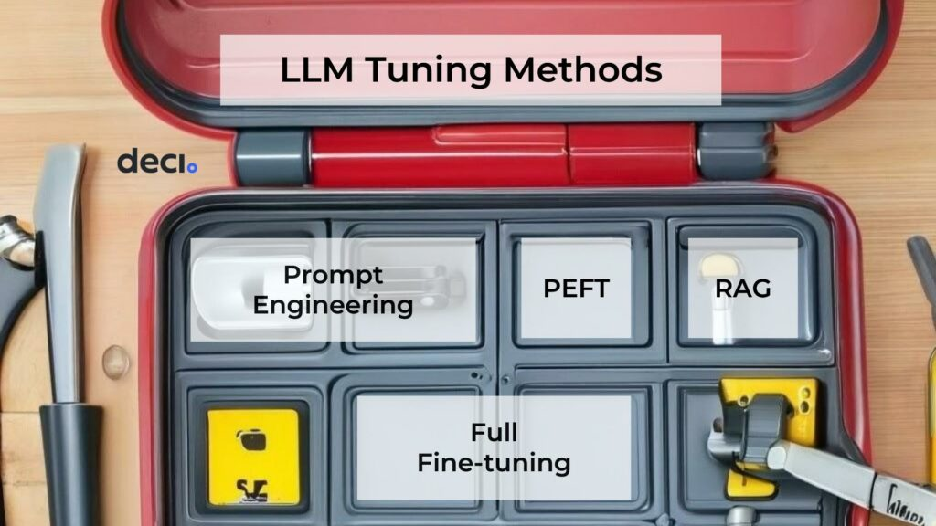
Utilizing LLMs
Quantization:
Changing the numerical precision of data to reduce memory consumption.
RAG
Retrieval-Augmented Generation: Enhancing model outputs by incorporating external information retrieved during the generation proces
Full Fine-Tuning
Adjusting all the model's parameters on a specific dataset to maximize performance for particular tasks.
Prompt Engineering:
Making an LLM function differently based on instructions.
Usage Strategies
Different learning strategies have been employed to use LLMs effectively, including tuning, quantization, and prompt engineering.
PEFT
Parameter-Efficient Fine-Tuning: Techniques to fine-tune models with minimal changes to their parameters.

Slide 36
Types of LLMs
Section 4

Slide 37
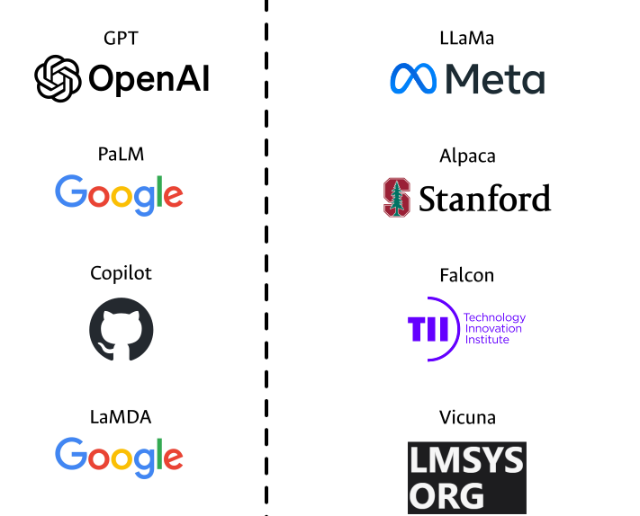
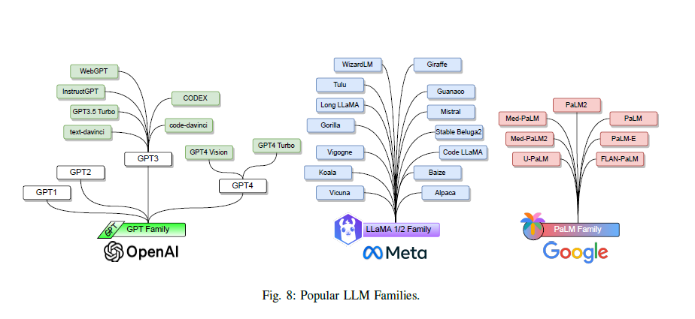
GPT Family
Generative Pre-trained Transformers
The GPT family, developed by OpenAI, includes several versions like GPT, GPT2, GPT3, GPT3.5, and GPT4, trained on vast datasets and costing millions to develop.

Slide 38
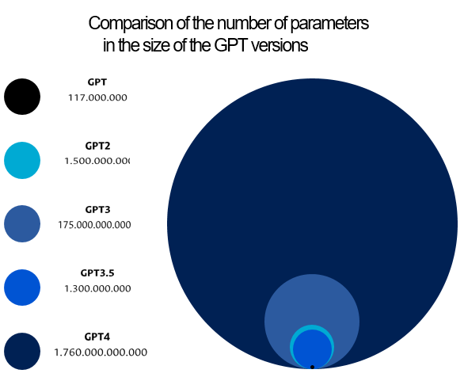




GPT Family
The Generative Pre-trained Transformers (GPT) models are a family of models developed by OpenAI.
There are several versions, including GPT, GPT2, GPT3, GPT3.5, and GPT4
The development of these models cost around 5 million dollars.
Generative Pre-trained Transformers
The models are trained with more than 400 billion words extracted from the web, books, articles, and other sources.

Slide 39

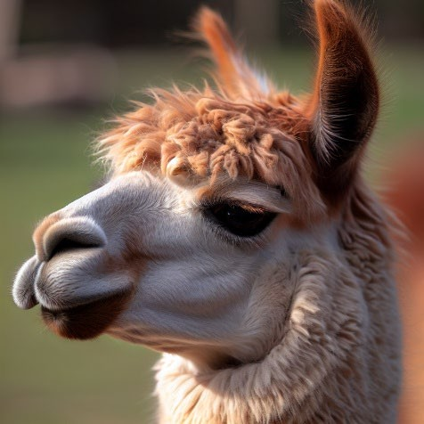
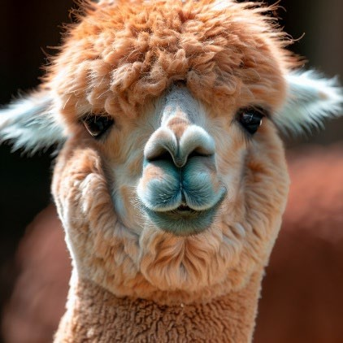
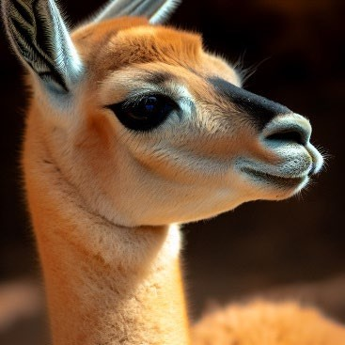
LLaMa, Alpaca, and Vicuna
LLaMa
Alpaca
Vicuna
Created by Meta.
It is open-source.
Versions with 7, 13, 33, and 65 billion parameters.
Created by Stanford University
It is open source.
It has 7 billion parameters.
Trained from GPT3.5 with the self-instruct approach.
It costs 600 dollars.
Created by LMSYS.
It is open source.
Trained with real ChatGPT conversations.
It has 13 billion parameters.
It costs 300 dollars.
Diverse Models
LLaMa by Meta, Alpaca by Stanford University, and Vicuna by LMSYS are examples of open-source models with varying parameters and costs, trained on different datasets.
Las 3 imágenes mostradas acá fueron generadas por DALL-E

Slide 40















LLM Tools
Modelos
Hugging Face GPT4All
OpenAI
Embeddings
Hugging Face Tensorflow Hub
OpenAI
Vector Databases
FAISS
ChromaBD
LanceDB
Datasets
ShareGPT FLAN
Hugging Face
LangChain
LangChain
Templates
Prompt design
Agents
Apps
ChatGPT DeepL
QuillBot

Slide 41

Farewell

